Slide 1
Case Study Project - Travel Insurance
Notes:
Good afternoon CEO, my name is Gerald and I am a Data analyst. I was tasked with the objective of finding the right place and people for out marketing team to advertise in as part of our cost cutting initiatives due to the COVID pandemic. Today, I will be presenting my findings to the team.

Slide 2
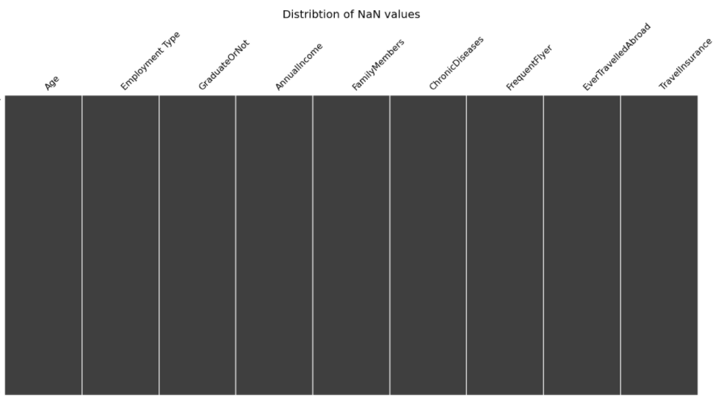
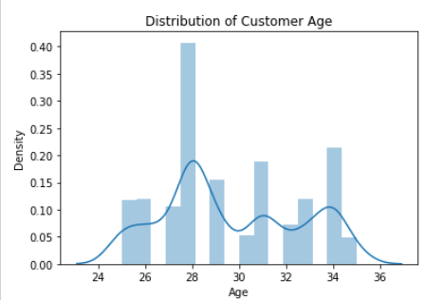
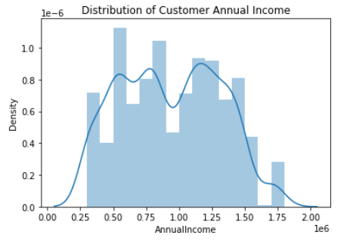
Exploratory Data Analysis
No Null values in our dataset
Our customer base has a narrow age range that is mainly from 25 to 35 years old, with most customers being 28 year old.
Our customer base has a large income range that is from 30 to 180K, the distribution also seems to be bimodal with 2 peaks at 75K and 110K respectively.
Notes:
Before starting my analysis, I did a sanity check on my data for any Null values which will potentially affect my results and did not find any in my data set. I moved on to exploratory data analysis and found of that our customer base are mainly made up of millennials that are 25 to 35 years old with most of them being at 28 year old. They also have a large income annual income range from 30 to 180K per year.

Slide 3
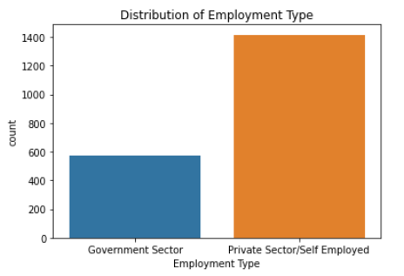
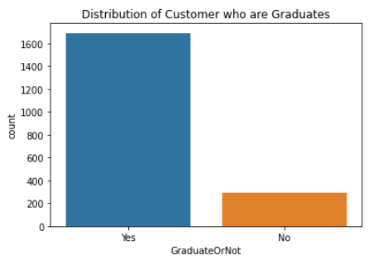
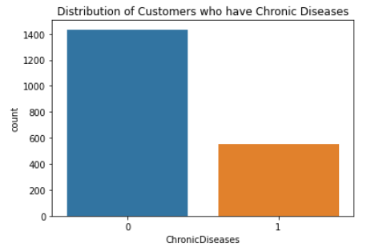
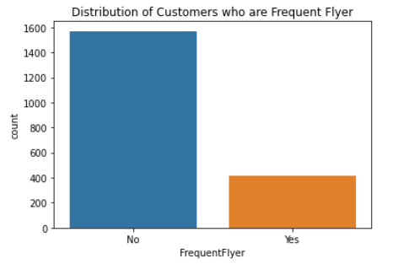
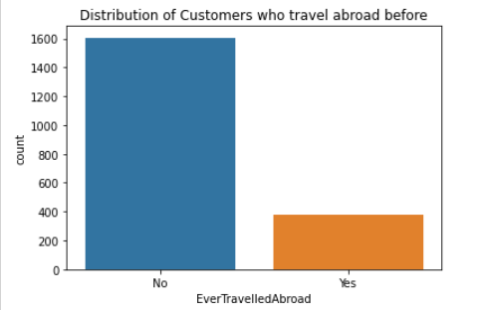
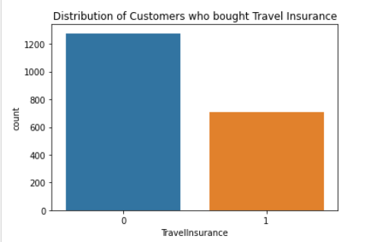
Exploratory Data Analysis
Customers profile:
Works in private sector
Non-graduates
Do not have chronic diseases
Not frequent flyer
Did not travel abroad before
Did not buy travel insurance
Notes:
Generally our customers have the following profile. They work in the private sector and are non-graduates. They do not have chronic diseases, are not frequent flyer and did not travel abroad before. Most importantly, most of them did not buy travel insurance from our company.

Slide 4
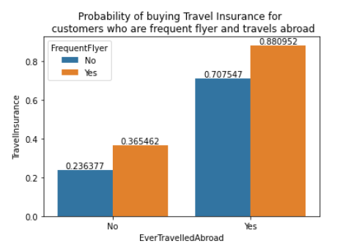
Differences in the travel habits between customers and non-customers
Between customers and non-customers, we can see that our customers are more likely to travel abroad before and also they are more likely to be frequent flyers.
This is most likely the customers our advertising team should be targeting on.
Notes:
Further deep diving into the date between our customers and non-customers, I found out that our customers are more likely to travel abroad before and also they are more likely to be frequent flyers. This can be seen from the graph where 88% customers who travel abroad before and are frequent flyer will buy our travel insurance, as compared to only 24% of our customers who are non-frequent flyer and have not travelled before buying our insurance.
This insight also make it most likely that our advertising team should be targeting customers who are frequent flyer and travel abroad before.

Slide 5
Finding out the right people to advertise
logistic regression on data set Using statsmodel package
Notes:
To find out who will be the right people to advertise to, I will conduct logistic regression to predict whether a customer will buy our travel insurance and subsequently using that results to decide on the customer’s attribute our marketing team should focus on.

Slide 6
Logistic Regression
To predict whether a customer will buy “TravelInsurance”(Objective)
Based on factors such as “Age”, “Employment Type”, “GraduateOrNot”, “AnnualIncome”, “FamilyMembers”, “ChronicDiseases”, “FrequentFlyer” and “EverTravelledAbroad”
Summary page from logistics regression results will give both the p-value and coef
p-value : probability that the relationship between factors and objective is a result of random chance
Coef: can be used to find odds ratio which shows the increase in probability of a customer buying our travel insurance for a given factor
Notes:
I will be using logistic regression machine learning model to predict whether a customer will buy our travel insurance given factors such as “Age”, “Employment Type”, “GraduateOrNot”, “AnnualIncome”, “FamilyMembers”, “ChronicDiseases”, “FrequentFlyer” and “EverTravelledAbroad”.
After the analysis, I will be able to find out the p-value of each factor. This will tell me whether this factor should be what our marketing team be focusing on.
The signs of coefficient values that are found from the analysis will decide the direction of factor that the marketing team should focus on.

Slide 7
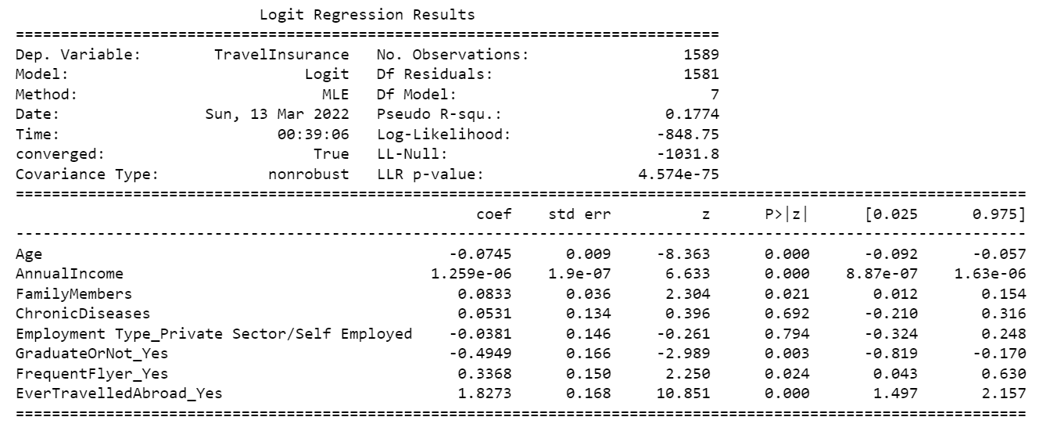
Summary Results
Most significant variables are “Age”, “AnnualIncome”, “FamilyMembers”, “GraduateOrNot”, “FrequentFlyer” and “EvertravelledAbroad”
These are also the factors that the marketing team should focus on.
Notes:
From results, we can see that “Age”, “AnnualIncome”, “FamilyMembers”, “GraduateOrNot”, “FrequentFlyer” and “EvertravelledAbroad” have p-values <0.05, which means they are significant in determining whether a customer will buy our travel insurance. These are also the customer attributes that the marketing team be focusing on.

Slide 8
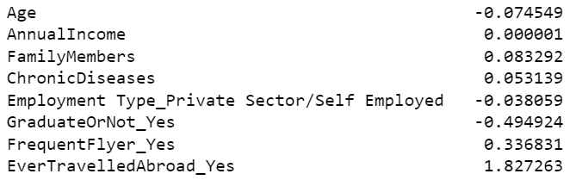
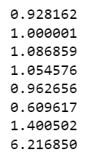

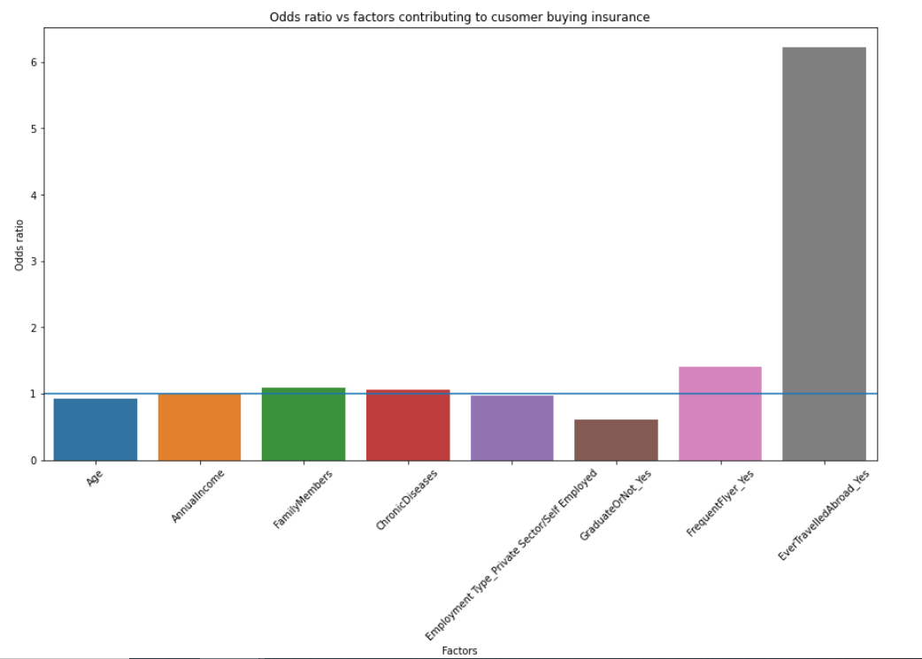
Summary Results
Odds ratio is the increase in probability of customers buying our insurance given a certain variable
From the previous slide and using only the significant variables. We can see that “EvertravelledAbroad” is the variable and that have the greatest odd ratio. Thus, this should be the main group of people the advertising team should be targeting.
Other than the above group, marketing efforts should be targeted at people with a younger age that has high annual income. They should preferably have more family members and are not graduates. They should also be frequent flyers that have travel abroad before.
Variable
Coef
Odds ratio
Notes:
From the graph above, we can see that “EvertravelledAbroad” has the greatest odds ratio. A high odds ratio the increase in probability that our customer will buy our travel insurance. Therefore, customers who travelled abroad before should be the main group of people our advertising efforts be on.
In conclusion, to maximize the chance of a customer buying our travel insurance, we should target our marketing efforts at people with a younger age that has high annual income. They should preferably have more family members and are not graduates. They should also be frequent flyers that have travel abroad before.
I’ve come to the end of my presentation and thank you for your time.

